Slide 1
Bray Team Week 5 Update
Avery Haynes, Locke Lehmann, Travis Carlson, Cody Sims, Zachary Walker, Michael Hager
2/19/2024

Slide 2
Weekly Deliverables
Tasks | Lead | Percentage Done | Notes
Implement sensors into system | Zack/Locke | 40% | Drilled into valve for sensor.
Purchase remaining parts | Avery | 100% | Strain Gauges purchased, awaiting arrival.
Wire sensors into DAQ and computer | Michael | 50% | Wired connections made for one deliverable.
Check on FEDC pressurized air availability | Travis | 100% | All parts purchased, awaiting arrival.

Slide 3
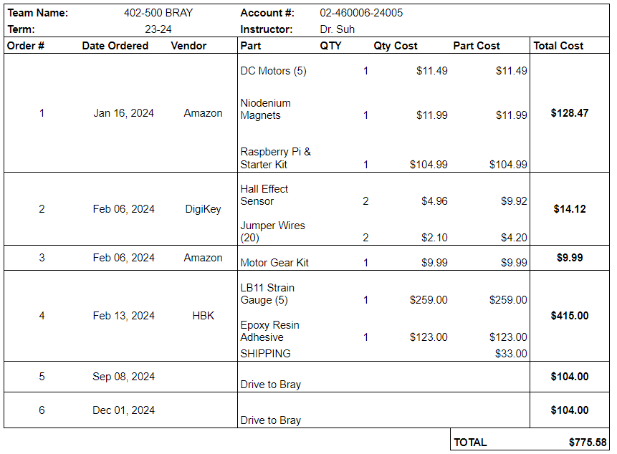
Purchasing Updates
Orders from Amazon & DigiKey (# 2, 3) arrived Friday, 2/16
Waiting on strain gauges and adhesive from HBK (# 4)
Need a solenoid valve & regulator to power the pneumatic actuator (sent from Bray)
Waiting on A6 actuator & valve repair kit (sent from Bray)
Budget Update: $775.58 spent (out of $3,803 approved)
Notes:
Done - Avery 2/18

Slide 4
NDA Items
Need written consent for us to participate in the Project Showcase, with outlines on what we shouldn’t talk about
The MEEN media team wants to interview us for our work, need guidelines on what we can/ can’t show as well

Slide 5
Final Presentation
Need to decide if our final presentation should take place in College Station or Cypress

Slide 6
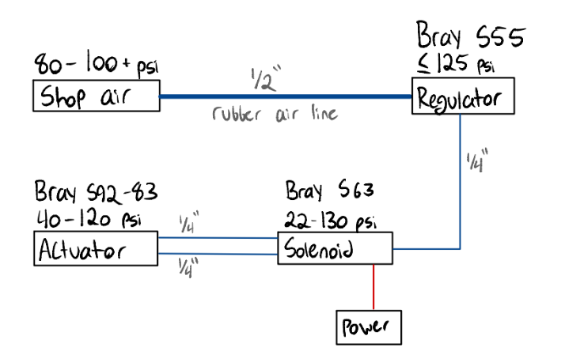
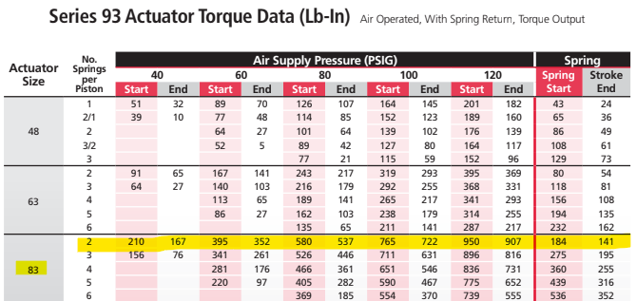
Toggling S92 Actuator
FEDC Shop air supply working again (100 psi)
Need a regulator & solenoid to (safely) toggle pneumatic actuator
S55 Filter Regulator, S63 Solenoid & fitting connections?
Notes:
Done - Avery 2/18

Slide 7
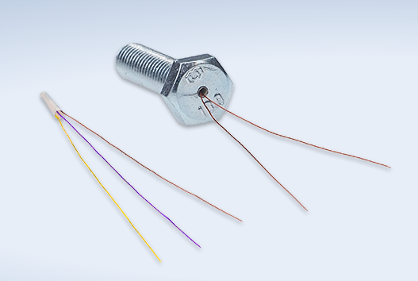
Strain Gauges
Ordered Cylindrical Strain gauges from HBK on 2/16
Using a resin epoxy to set them into S92 stop bolts, should be safe to cure in an oven? (140 F)
2mm hole drilled into the bolt to a depth of maximum stress

Slide 8
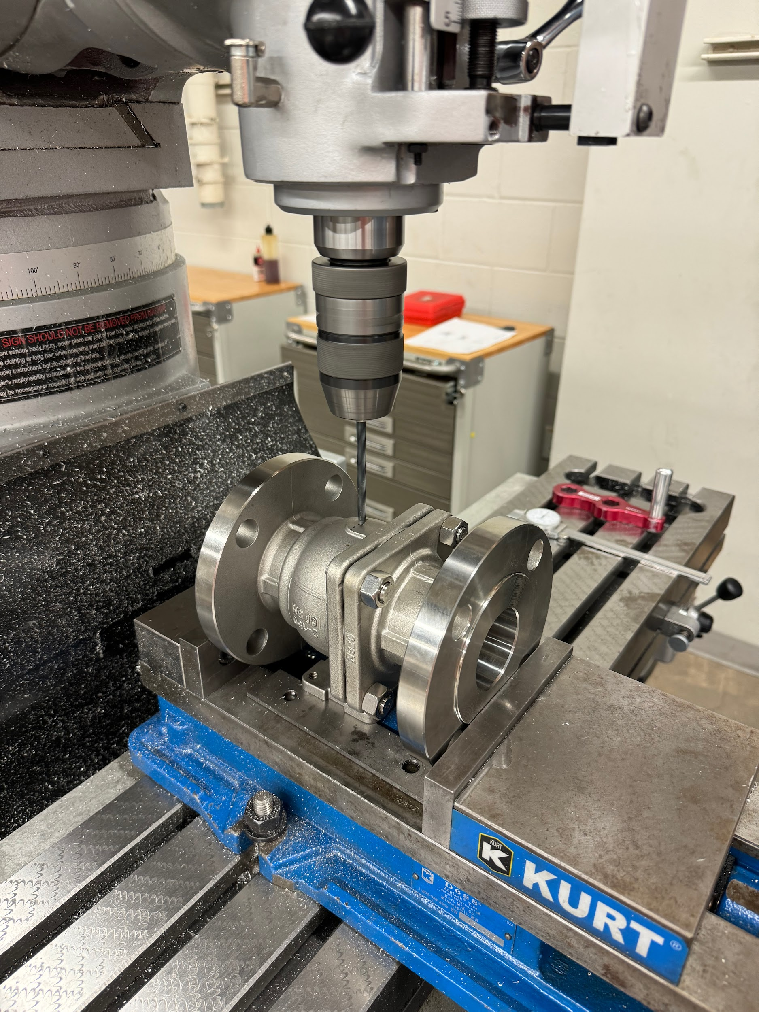
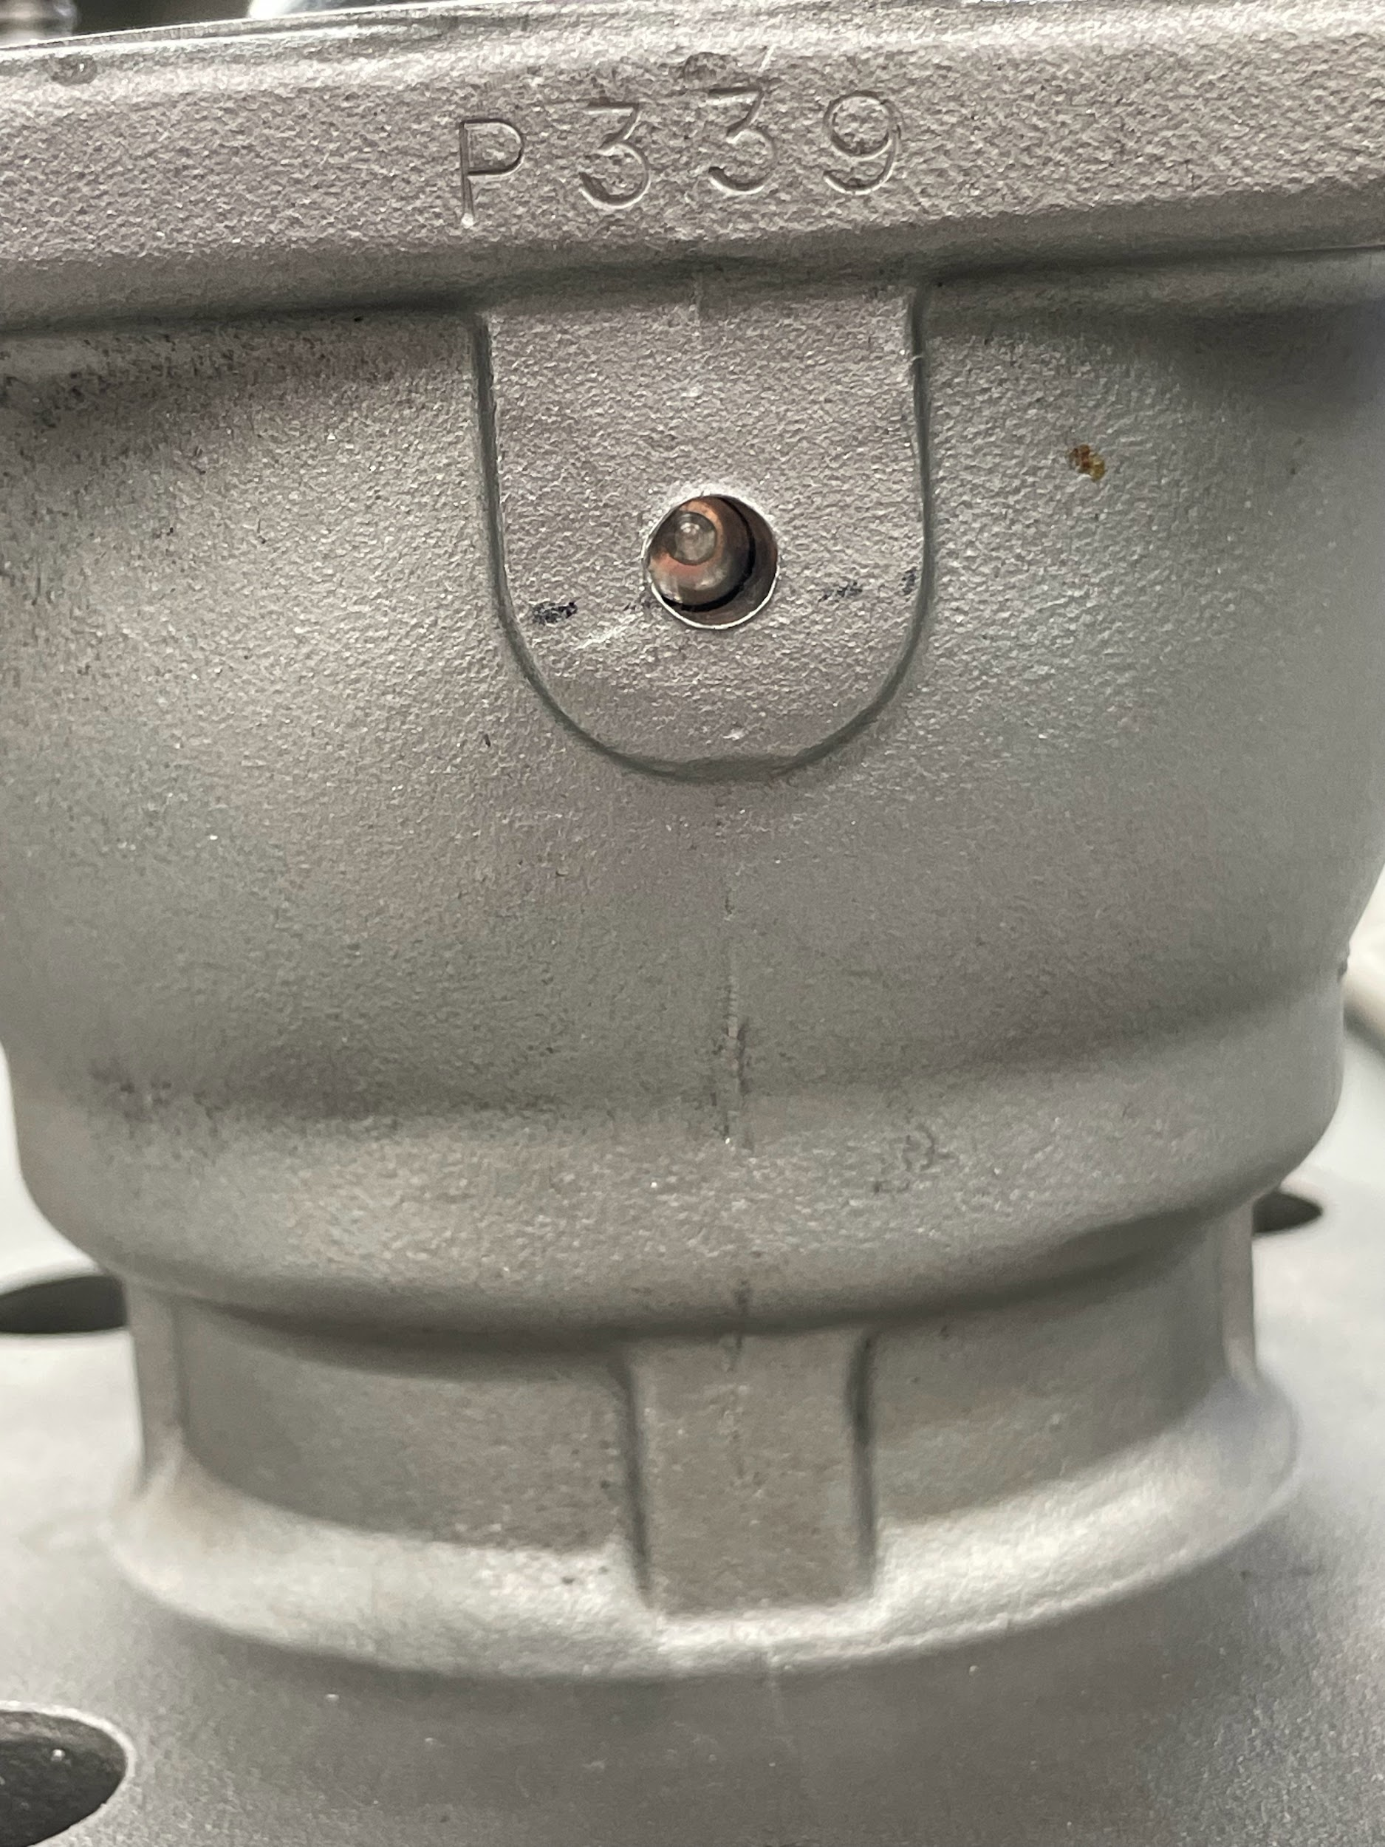
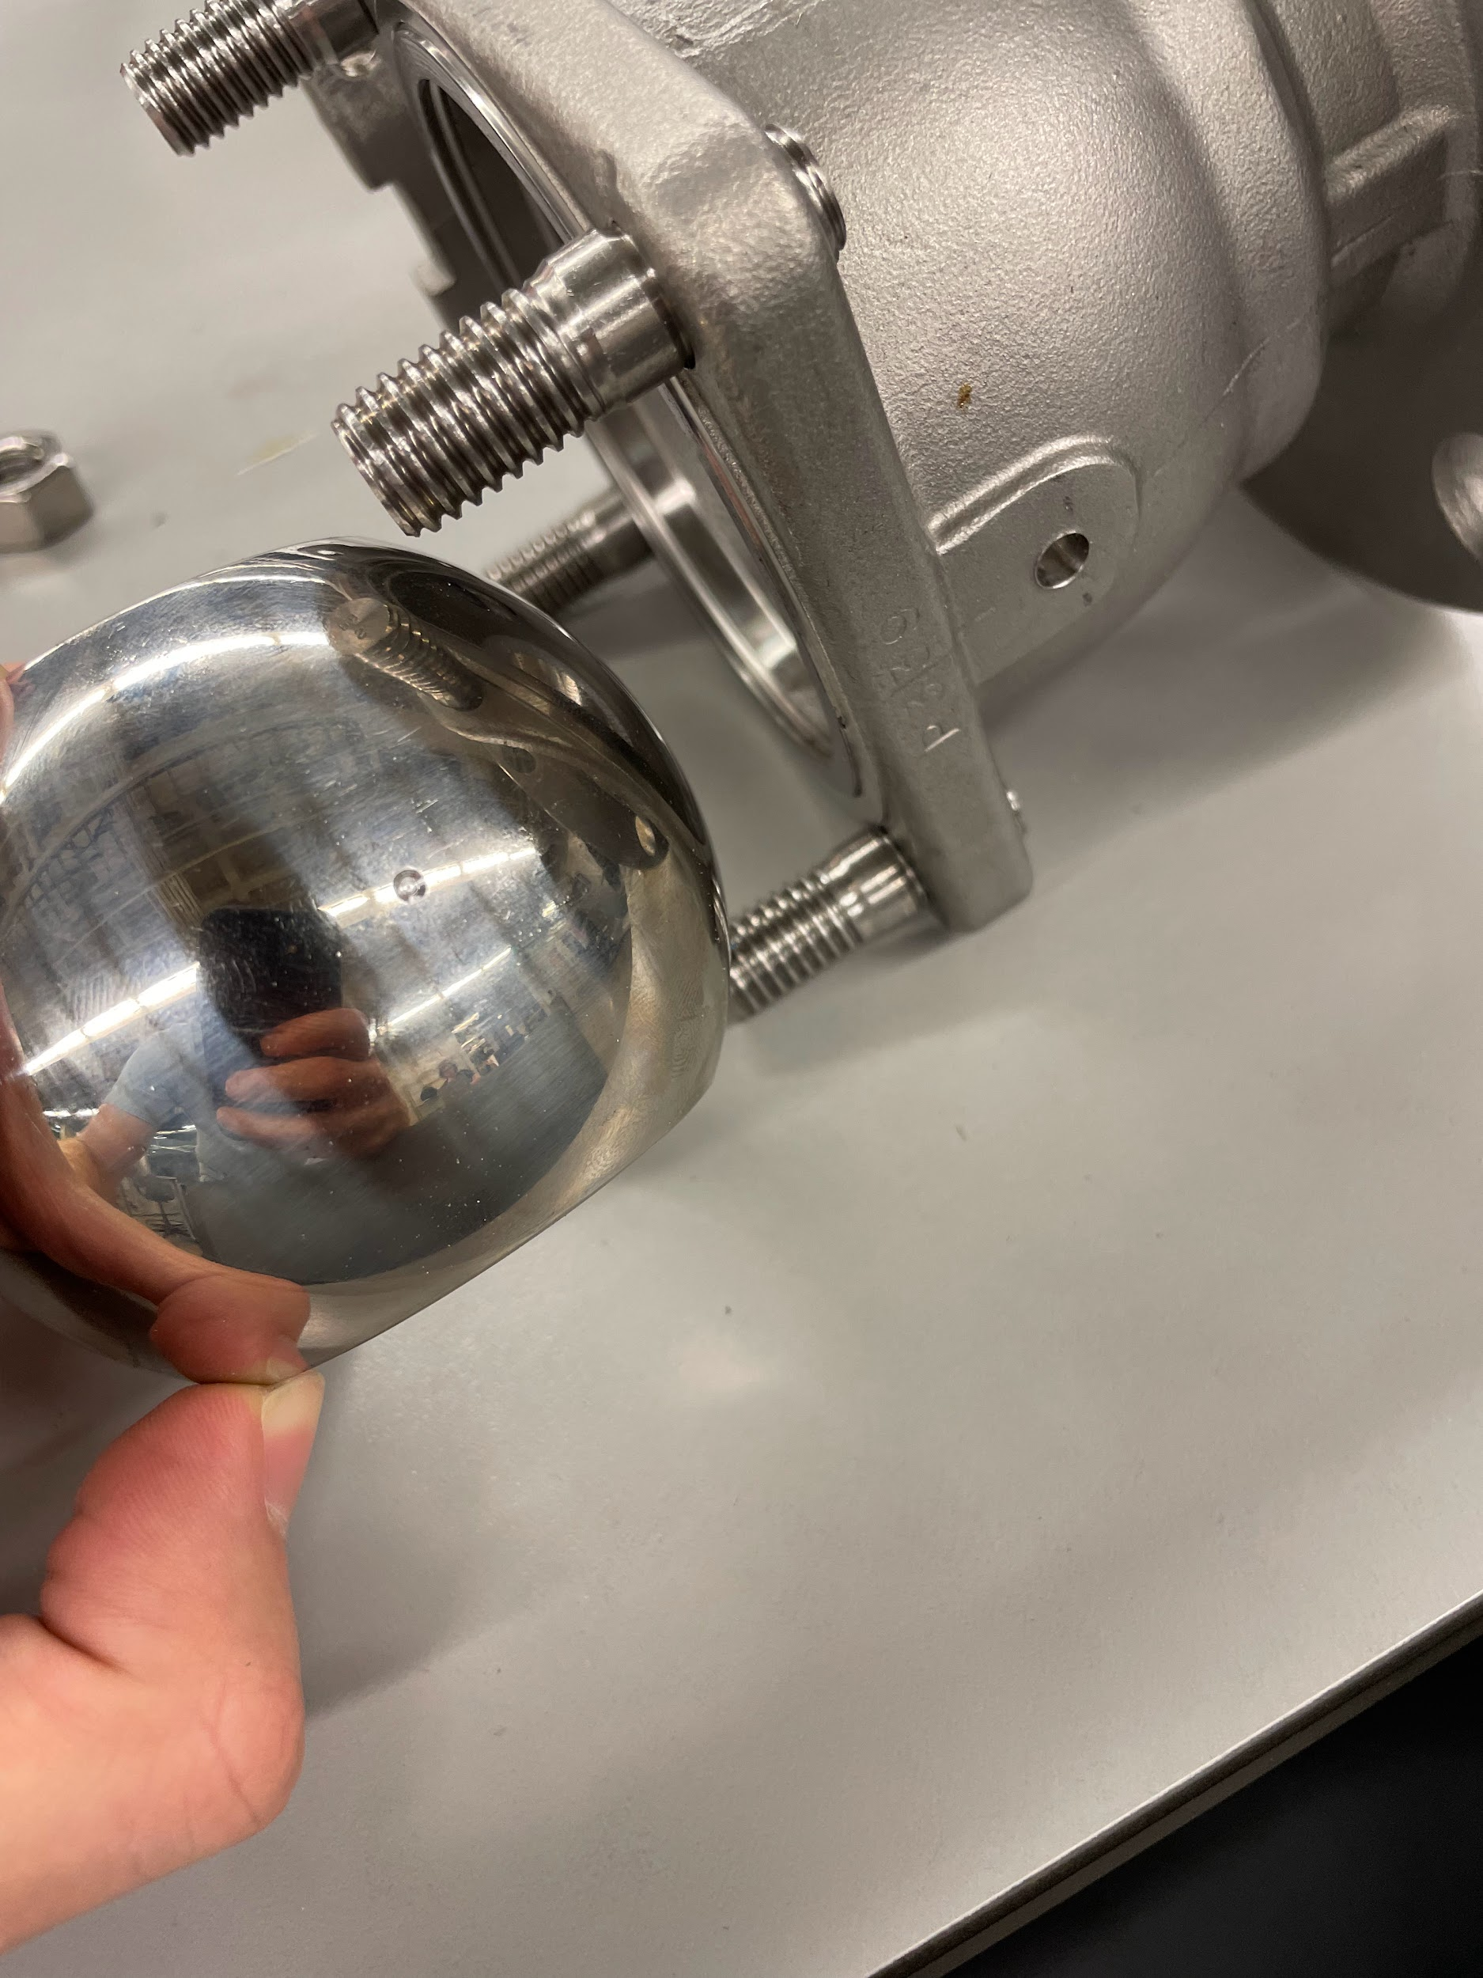
Potentiometer Drilling
AFTER taking out and re-inserting ->

Slide 9
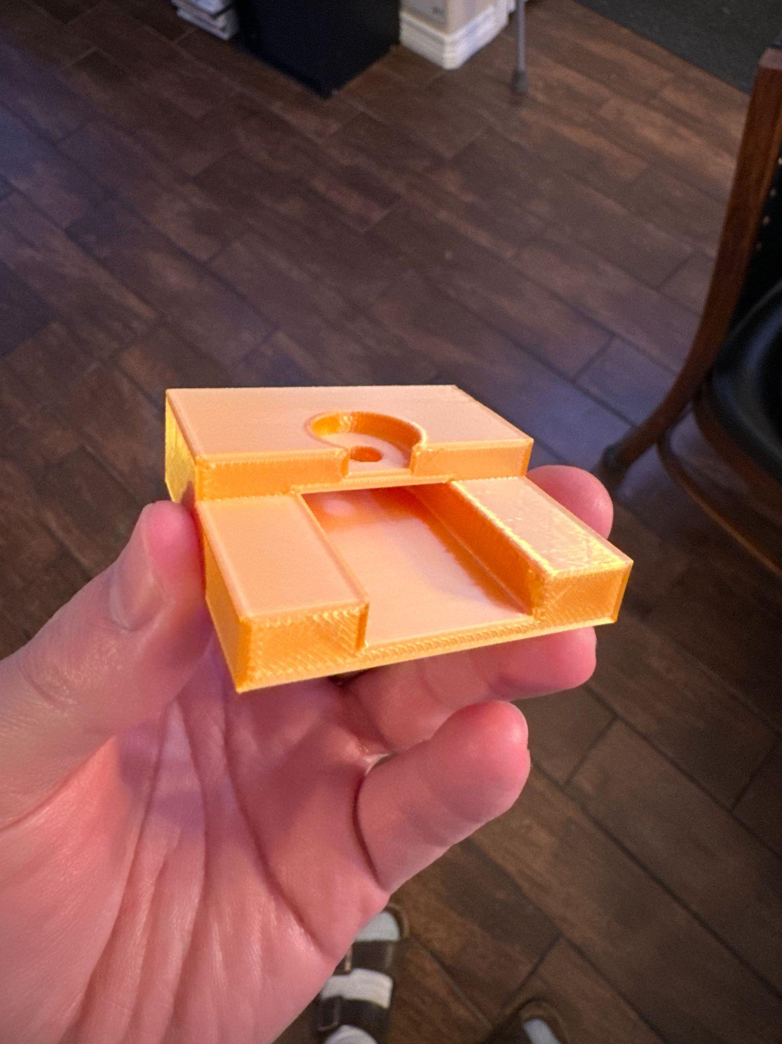
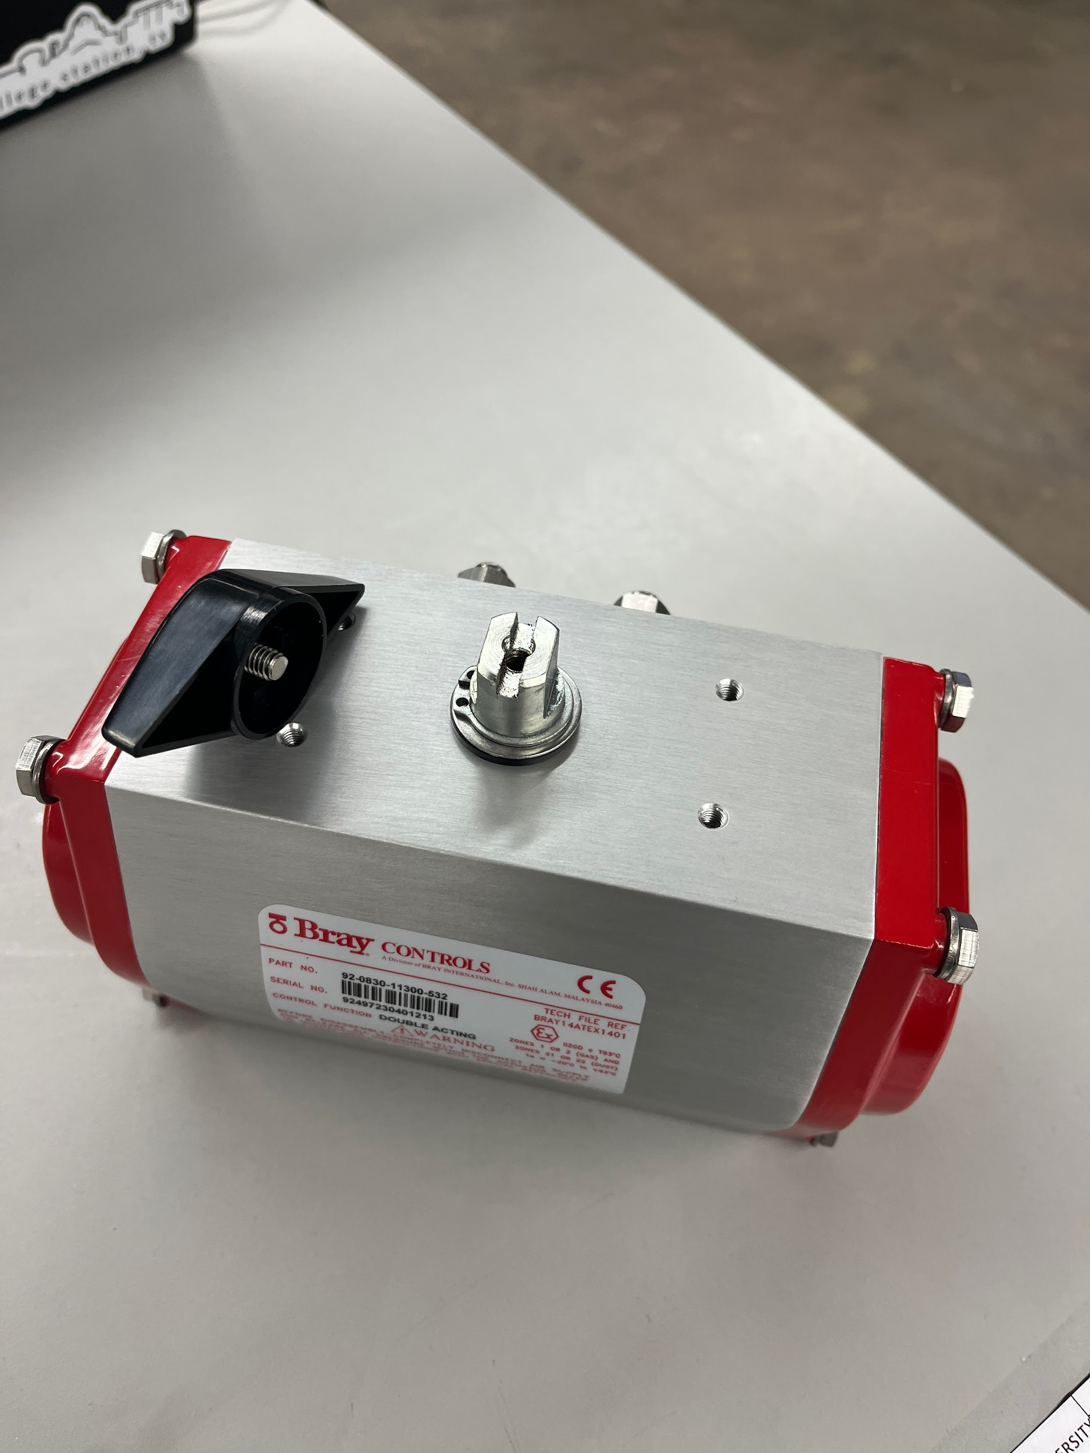
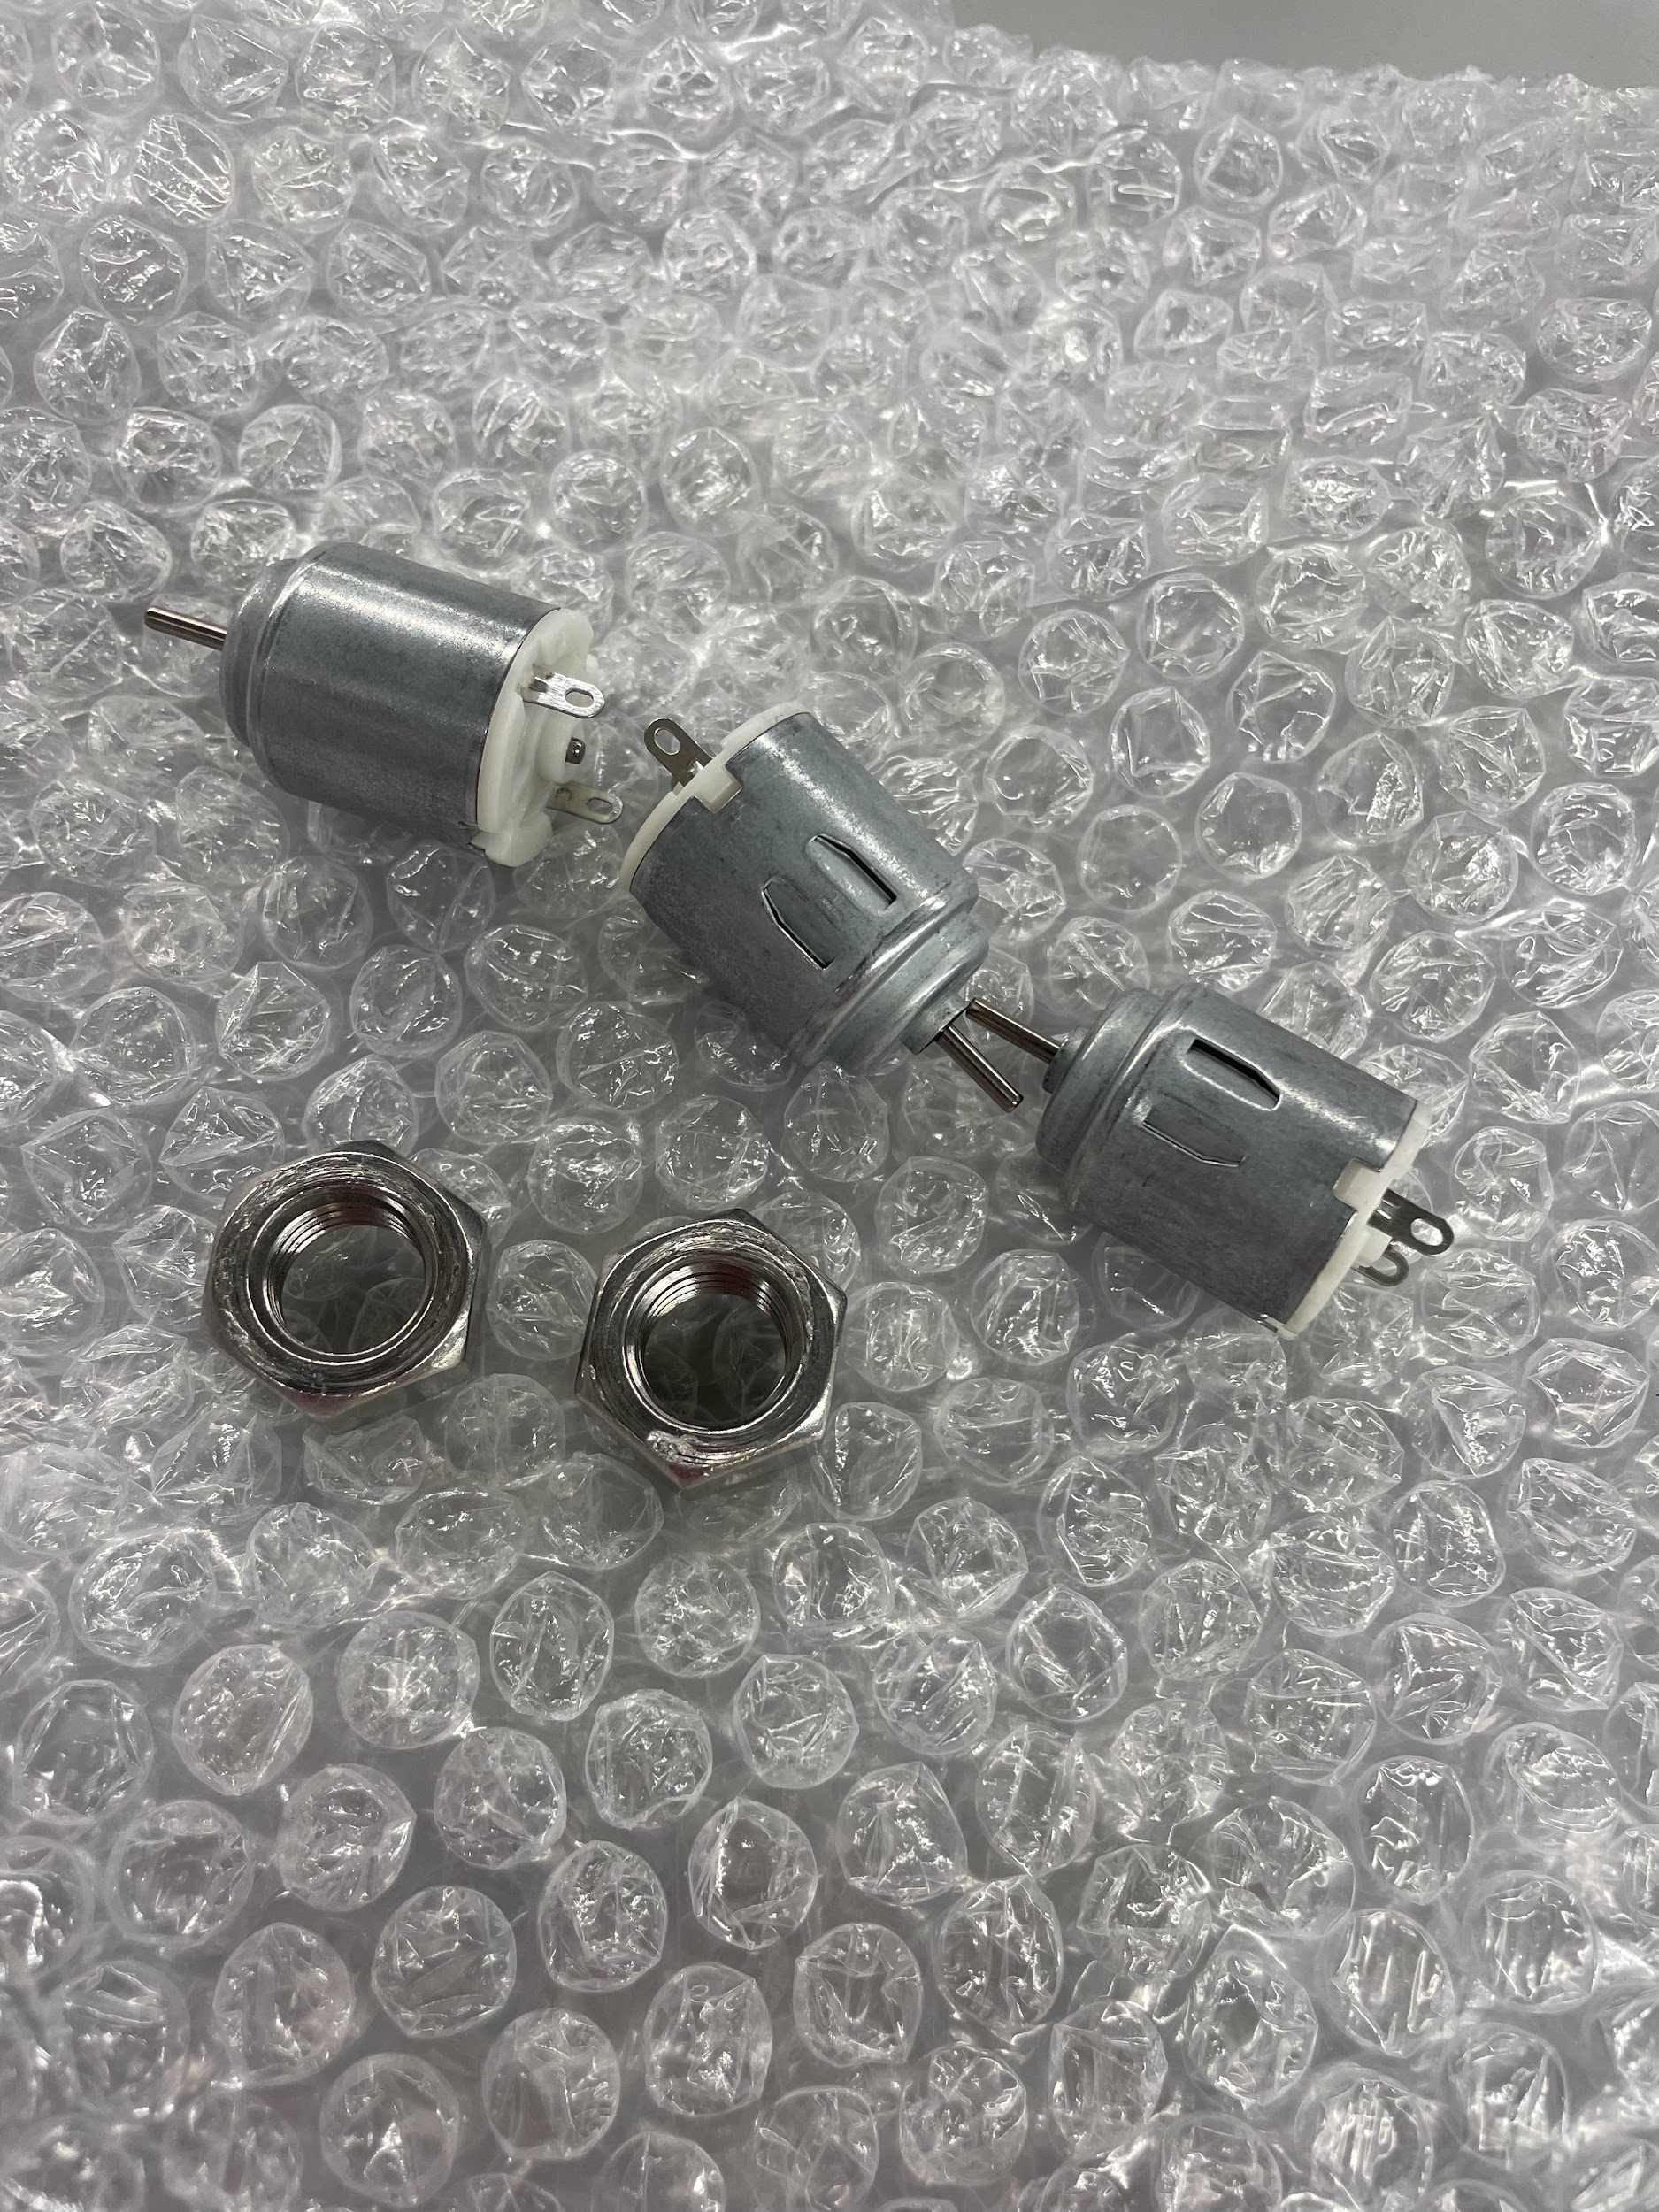
Motor Bracket
No longer need to mount on the side.
The motor can attach directly to the stem of the actuator using the gear set that was picked up today.
Reduces # of moving parts which increases accuracy.
Week 4 Variation

Slide 10
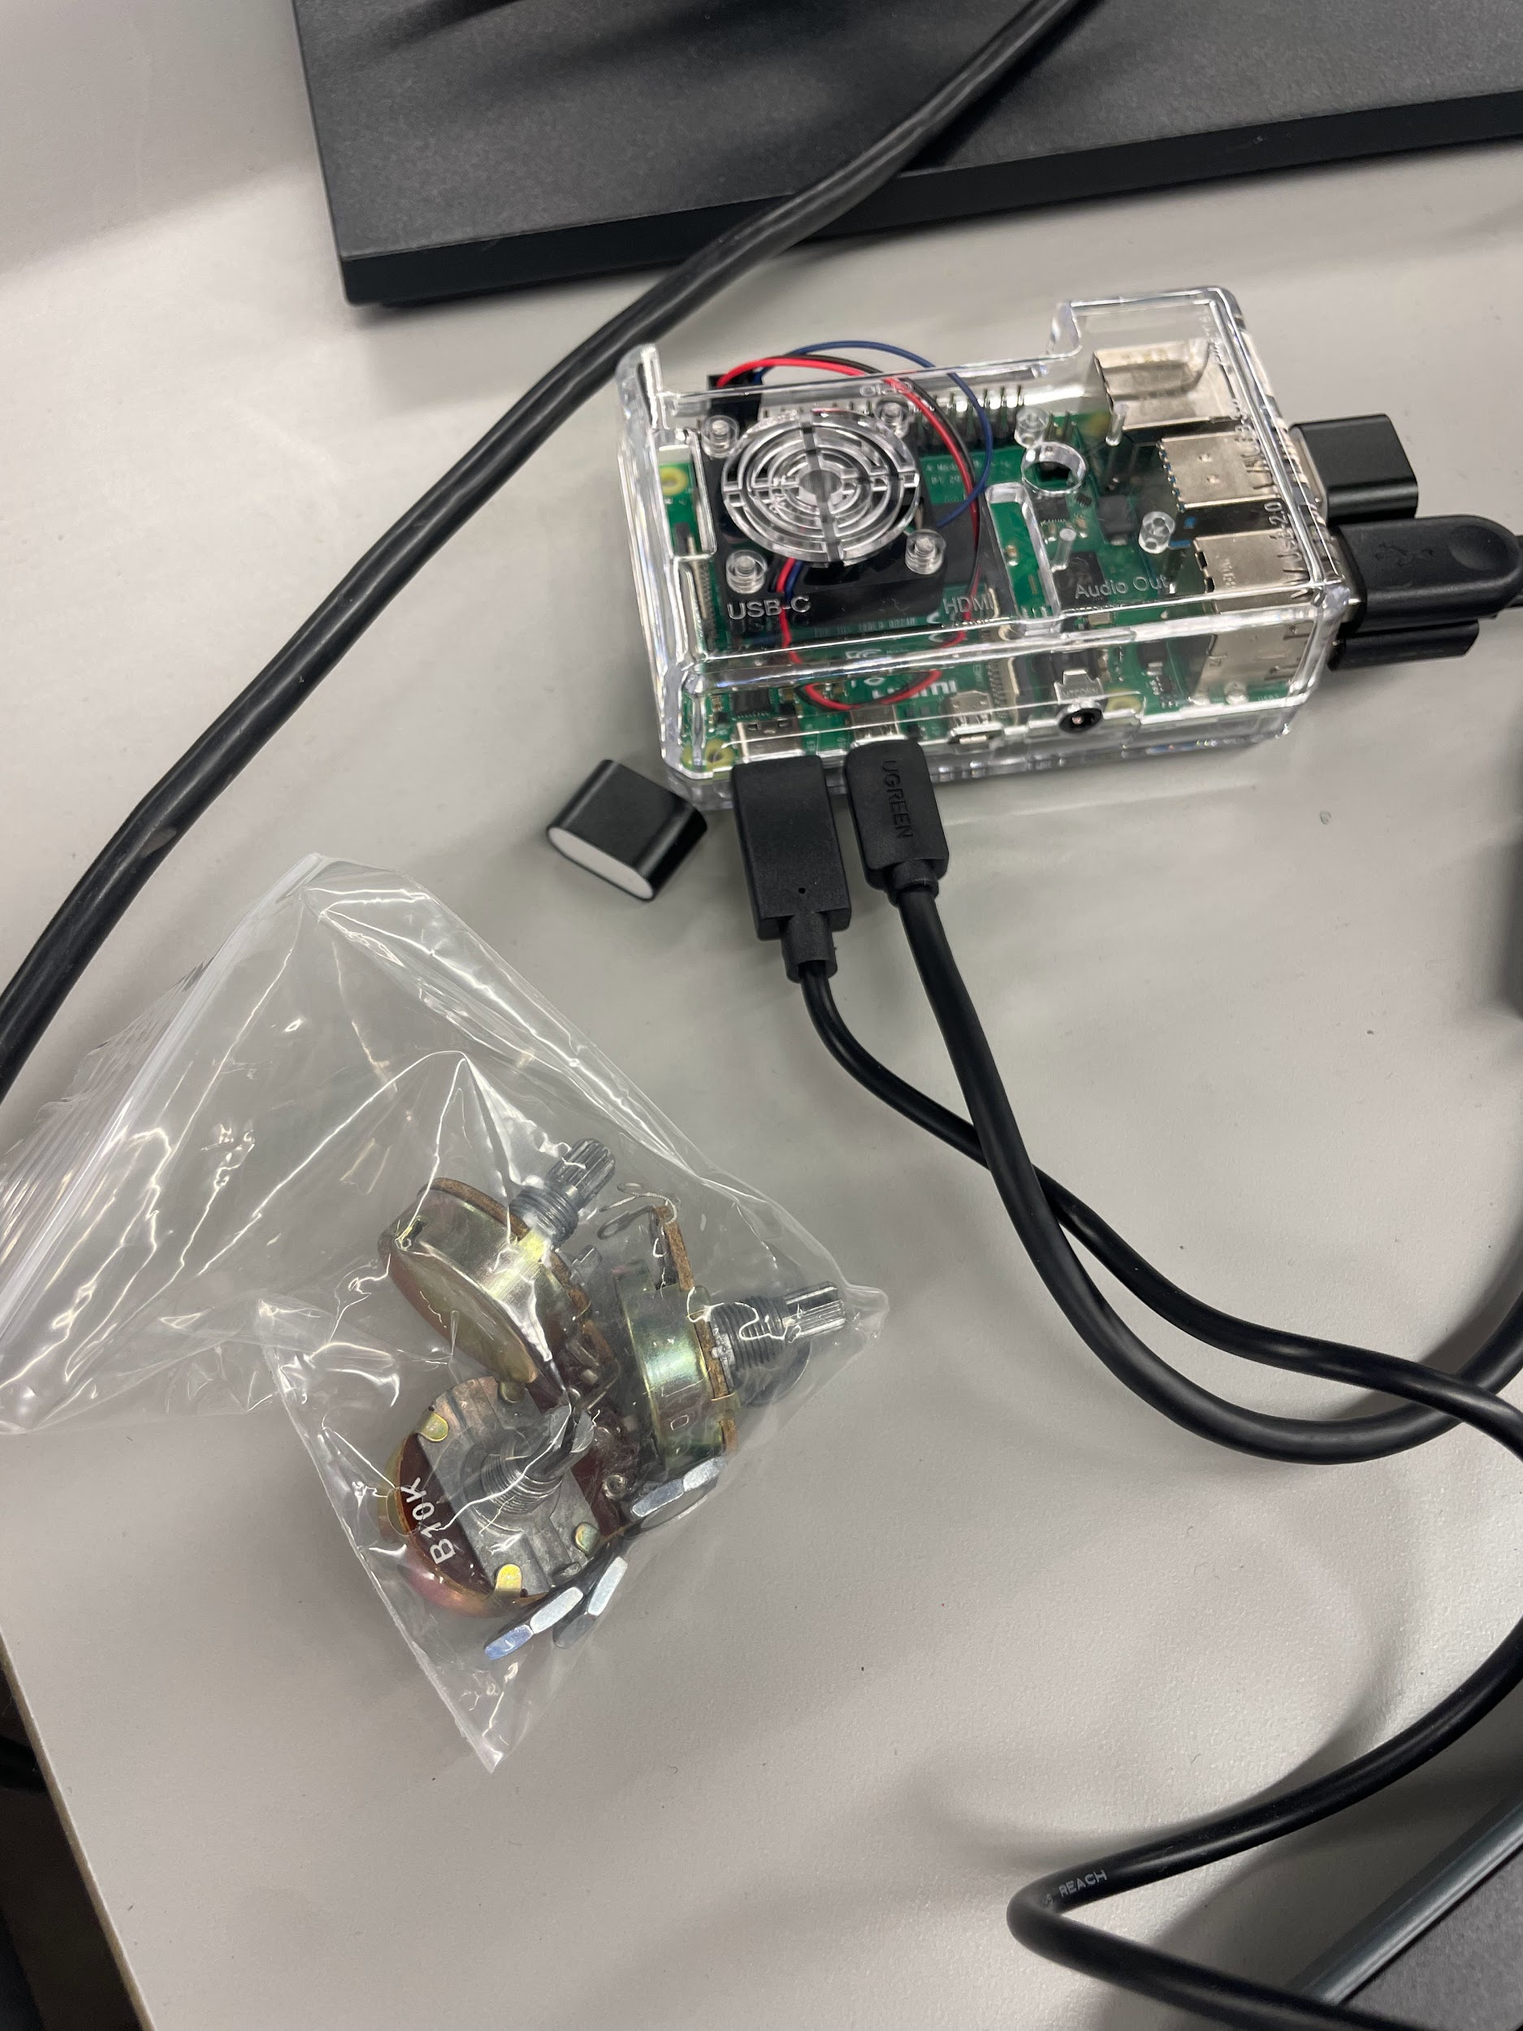
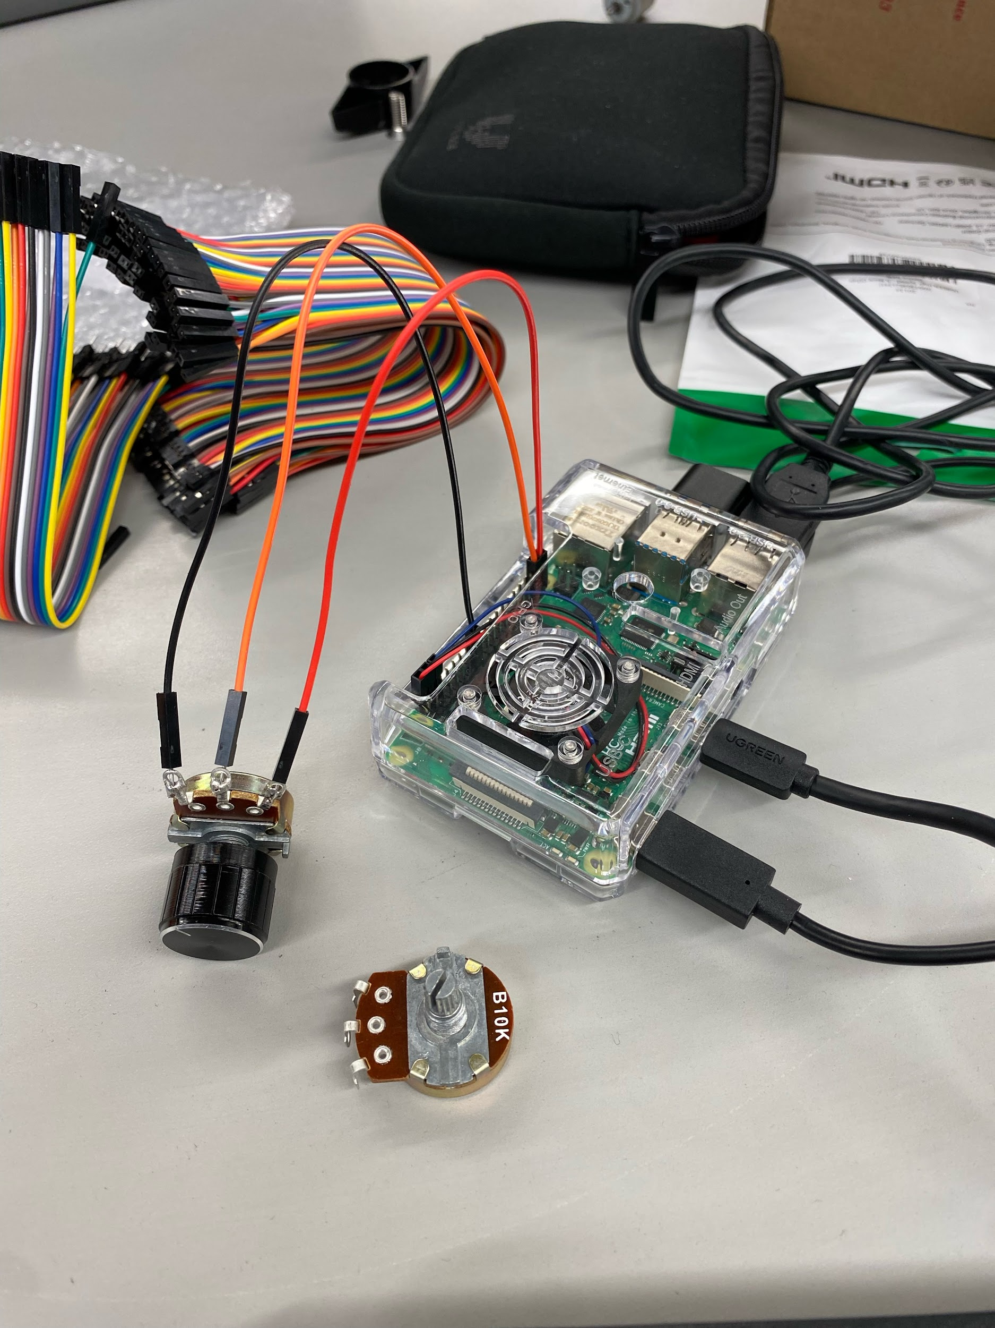
Raspberry Pi / Soldering

Slide 11
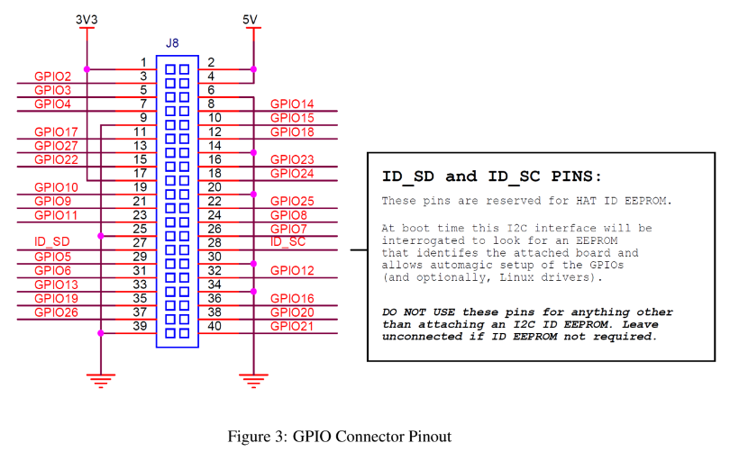
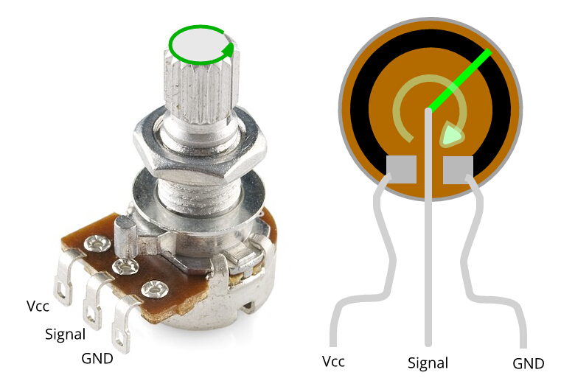
Data Analysis

Slide 12
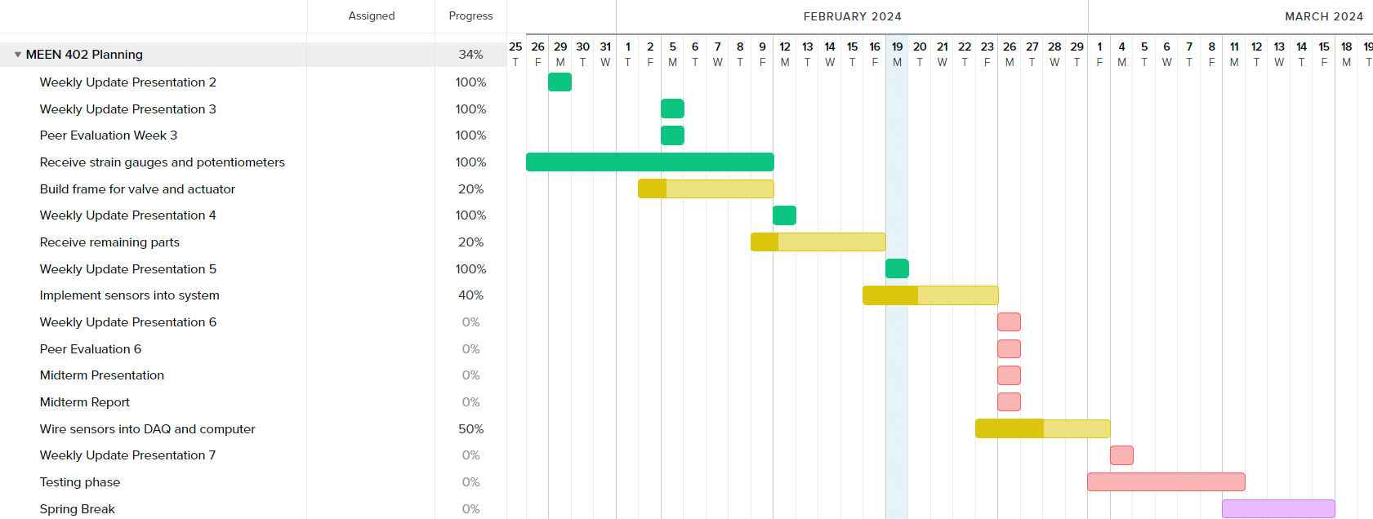
Gantt Chart

Slide 13
Next Week's Deliverables
Tasks | Lead | Percentage Done | Notes
Receive remaining parts | Avery | 20% | Awaiting arrival.
Build frame for valve and actuator | Cody/Travis | 20% | Awaiting arrival.
Implement sensors into system | Zack | 40% | Drilled into valve for sensor.
Wire sensors into DAQ and computer | Michael | 50% | Wired connections made for one deliverable.
Complete FMEA table | Locke | 20% | Have 2 fault modes completed
Compete Report and presentation | all | 0% | Have not started writing but have some materials ready

